Slide 1
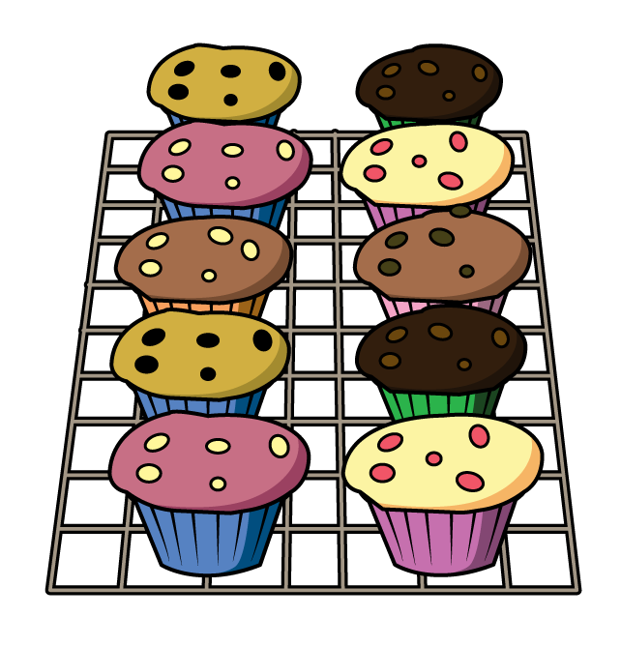
Year 1 | Week 9| Day 1

Slide 2


Year 1 | Week 9| Day 2

Slide 3
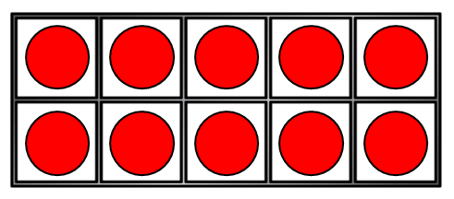
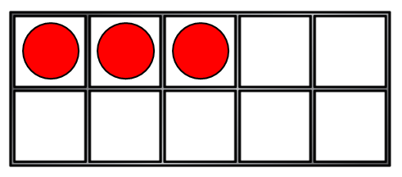
Year 1 | Week 9| Day 3

Slide 4
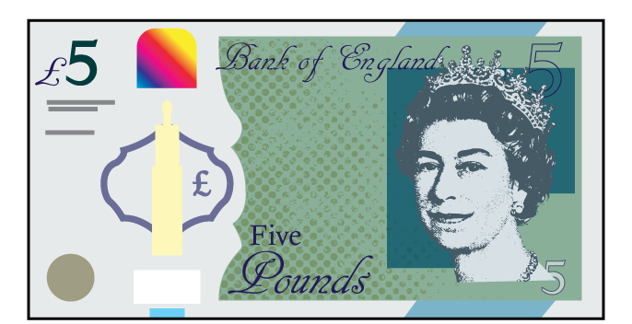



Year 1 | Week 9| Day 4

Slide 5

Year 1 | Week 9| Day 5

