Slide 1


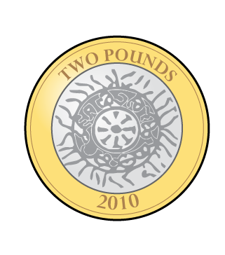
Year 1 | Week 10| Day 1

Slide 2
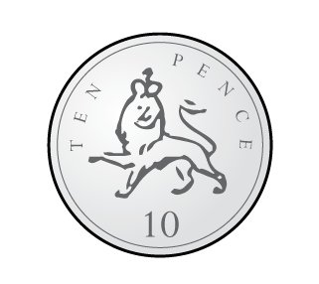


Year 1 | Week 10| Day 2

Slide 3

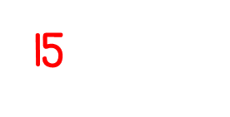
Year 1 | Week 10| Day 3

Slide 4

Year 1 | Week 10| Day 4

Slide 5

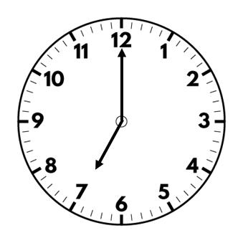
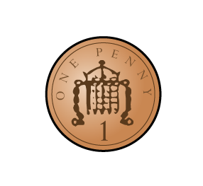
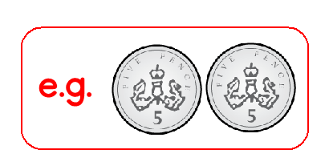
Year 1 | Week 10 | Day 5

Slide 6

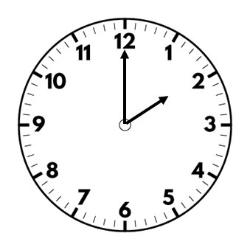
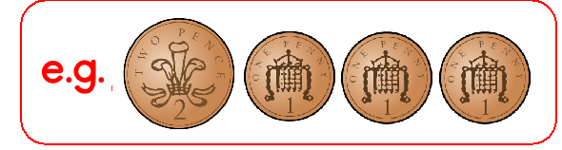
Year 1 | Week 11 | Day 1

Slide 7
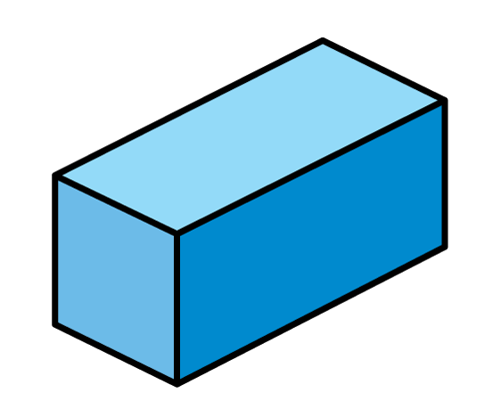
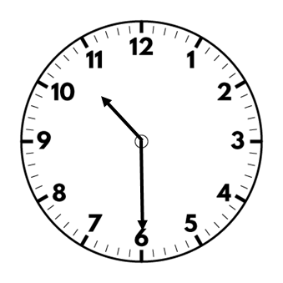

Year 1 | Week 11 | Day 2

Slide 8

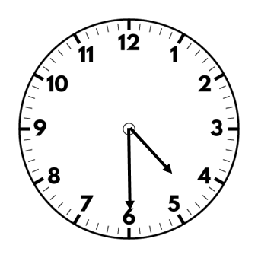

Year 1 | Week 11 | Day 3

Slide 9

Year 1 | Week 11 | Day 4

Slide 10

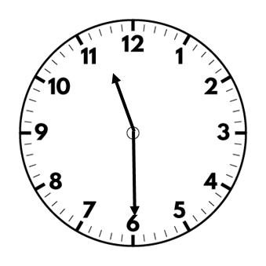
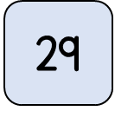
Year 1 | Week 11 | Day 5

